Slide 1
Jeffersonian to Jacksonian Democracy
The struggle to define and extend democratic ideals in the face of major changes

Slide 2
Jefferson
Election of 1800
  Ended in a tie between Jefferson and Burr
  Hamilton turned the tide in favor of Jefferson
Impact of the outcome
  12th Amendment- Electors would cast two separate votes. One for the President and one for the Vice President, in an attempt to avoid a tie situation.
  Burr holds a grudge against Hamilton- kills him in a duel years later

Slide 3
Jefferson as President
Changes in government
  Reduced government spending
    Revenue- only from customs duties and sale of lands
    Smaller Executive branch
  Reduced Military size/spending
    Smaller army and navy
    But increased navy to combat pirates
Louisiana Purchase
  Negotiations with Spain for the port of New Orleans
  Negotiations with France- Napoleon’s offer
  Significance- Doubles the US

Slide 4
Jefferson and Madison
Foreign Issues
  France and England attacks on US ships
  Embargo Act
    Cut off trade with BOTH nations
    Impact: Economic Ruin
    Regional Views vs. National Views?
  Non-Intercourse Act
    Trade with ONE of the nations and NOT the other
    Impact: War of 1812

Slide 5
What are some major events leading to The War of 1812?
US shipping was being harassed, and cargo was seized.
  Britain required licenses for ships bound for Europe
  France confiscated cargo from licensed ships
Impressment of American sailors
  Many British sailors became naturalized US citizens and deserted British vessels and joined American crews.
  British Navy kidnapped these sailors off American ships and had them rejoin the British Navy

Slide 6
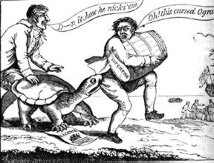
What are some major events leading to The War of 1812?
Economic Diplomacy Fails
  Embargo Act of 1807 halted all trade with Europe
  Embargo is a government ban on trade with other countries
  Embargo was unpopular in port cities, especially in the North

Slide 7
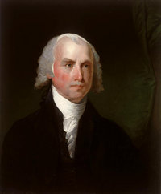
Jefferson Farewell
Enter James Madison
Jefferson did not want to run for a 3rd term
Madison was Jefferson’s Secretary of State
Madison was an author of 30 of the 81 the Federalist Papers (including No. 10 and No. 51)
Considered the most important contributor to the Constitution
Also the shortest President

Slide 8
What was Madison’s role leading up to The War of 1812?
Non-Intercourse Act
  Forbade trade with France and Britain; however President could reopen trade when either France or Britain lifted restrictions
  Was this successful? Why or Why not
War Hawks
  Southern congressmen favored war, even though it hurt the east
  Why did the War Hawks want war?

Slide 9
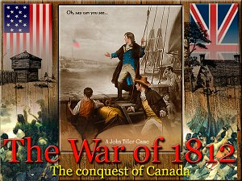
What were some of the benefits of going to war with Britain?
To allow reopening of trade
National Pride
To stop the impressment of sailors
CANADA!!!

Slide 10
What were some drawbacks to going to war?
Not everyone in the US wanted to go to war
Military was small
  Standing Army was small
  Militia comprised most of our forces, and they did not like to fight outside of their state borders
  Navy was quite small only 22 ships
Britain was a great Superpower and could crush us like a bug and we could lose territory that was gained in the Treaty of Paris or the Louisiana Purchase

Slide 11
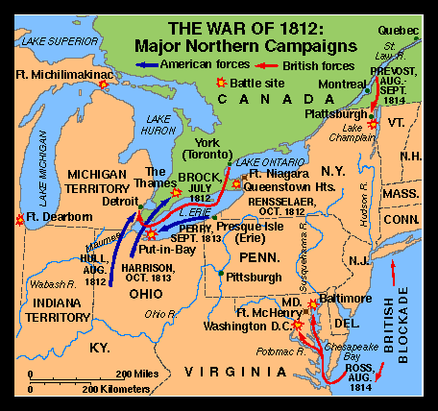
Declaration of War
June of 1812 Madison asked Congress for declaration of war
Vote was split along regional lines
War started with Invasion of Canada

Slide 12
Key Battles
US Burns York (now Toronto)
  US figured the Canadians would welcome the Americans and quickly join the US to expel Britain from North America…this did not happen
Perry Defeated the British on Lake Erie
  This gave the US control of Lake Erie
Britain Blockades the Eastern Seaboard
  This prevented shipping from leaving, and made the war more unpopular in the Northeast

Slide 13
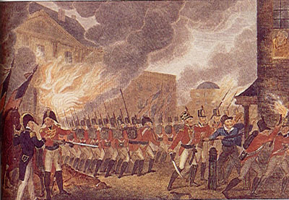
The Roof is on Fire…
In August 1814, British Forces Sailed into Chesapeake Bay and capture Washington D.C.
They burn the White House and the Capitol
Madison and Congress Barely escape

Slide 14
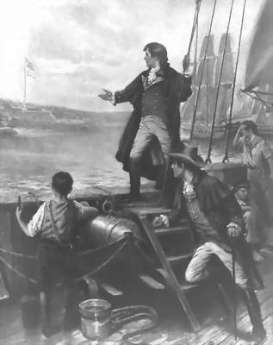
Oh Say Can You See…
Unlike D.C., Baltimore was Ready for the British
The City militia inflicted heavy casualties on the British
After bombarding Fort McHenry on September 13, 1814 The British abandon the attack
Francis Scott Key witnessed the bombardment and penned a poem which becomes the National Anthem.

Slide 15
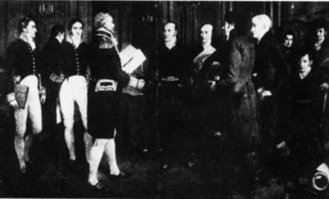
Treaty of Ghent
Treaty was Negotiated in Europe and was signed on Dec. 24, 1814 ending the war of 1812
The War ended in a stalemate, where no party gained or lost any territory.
The issue of impressment was not addressed, but faded on its own.

Slide 16
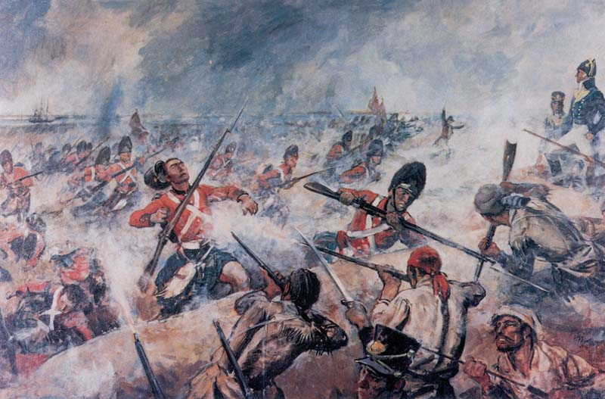
Battle of New Orleans
Fought after the treaty was signed (but not ratified)
Why was New Orleans important?
Pirates and Frontiersman fought alongside US troops
Made Andrew Jackson a National hero and household name
Ensured treaty ratification

Slide 17
If The War of 1812 ended in a tie, why was it important?
Gave the United States a National Identity
  We were able to hold our own against the British
  Started us thinking about continuing westward expansion
  Ended bad feelings toward the British
Creates a hero in Andrew Jackson and the Western Frontiersmen

Slide 18
The War’s Significance
It effectively destroyed the Indians' ability to resist American expansion east of the Mississippi River.
  General Andrew Jackson crushed the Creek Indians at the Battle of Horseshoe Bend in Alabama, while General William Henry Harrison defeated Indians in the Old Northwest at the Battle of the Thames.
  Abandoned by their British allies, the Indians reluctantly ceded most of their lands north of the Ohio River and in southern and western Alabama to the U.S. government.
The war allowed the United States to rewrite its boundaries with Spain and solidify control over the lower Mississippi River and the Gulf of Mexico.
  Although the United States did not defeat the British Empire, it had fought the world's strongest power to a draw.
  Spain recognized the significance of this fact, and in 1819 Spanish leaders abandoned Florida and agreed to an American boundary running clear to the Pacific Ocean.

Slide 19
The War’s Significance
The Federalist Party never recovered from its opposition to the war. Many Federalists believed that the War of 1812 was fought to help Napoleon in his struggle against Britain, and they opposed the war by refusing to pay taxes, boycotting war loans, and refusing to furnish troops.
  In December 1814, delegates from New England gathered in Hartford, Connecticut, where they recommended a series of constitutional amendments to restrict the power of Congress to wage war, regulate commerce, and admit new states. The delegates also supported a one-term president (in order to break the grip of Virginians on the presidency) and abolition of the Three-fifths clause in the Constitution (which increased the political clout of the South), and talked of seceding if they did not get their way.
The proposals of the Hartford Convention became public knowledge at the same time as the terms of the Treaty of Ghent and the American victory in the Battle of New Orleans. Euphoria over the war's end led many people to brand the Federalists as traitors. The party never recovered from this stigma and disappeared from national politics.

Slide 20
"The Era
of
Good Feeling"
1815-1824

Slide 21
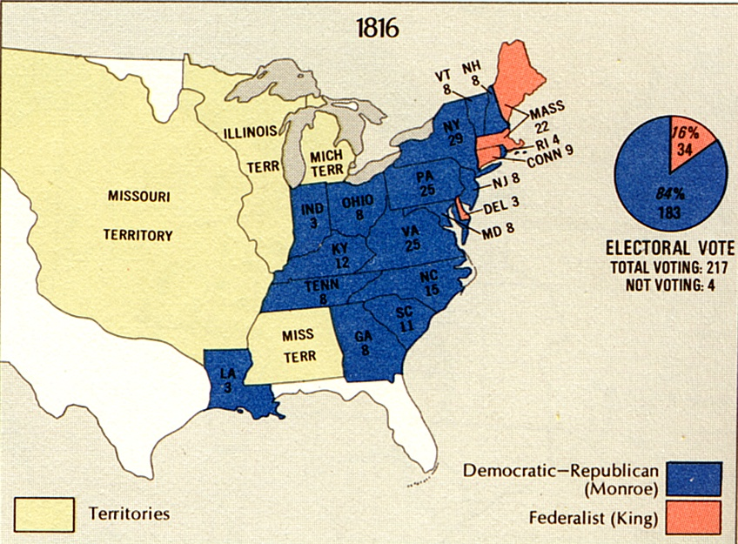
The Election of 1816

Slide 22
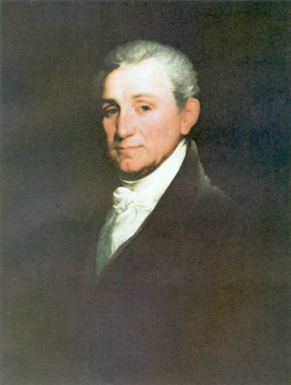
James Monroe [1816-1824]

Slide 23
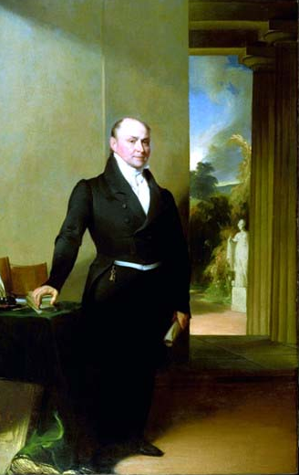
John Quincy Adams:
A bulldog among spaniels!

Slide 24
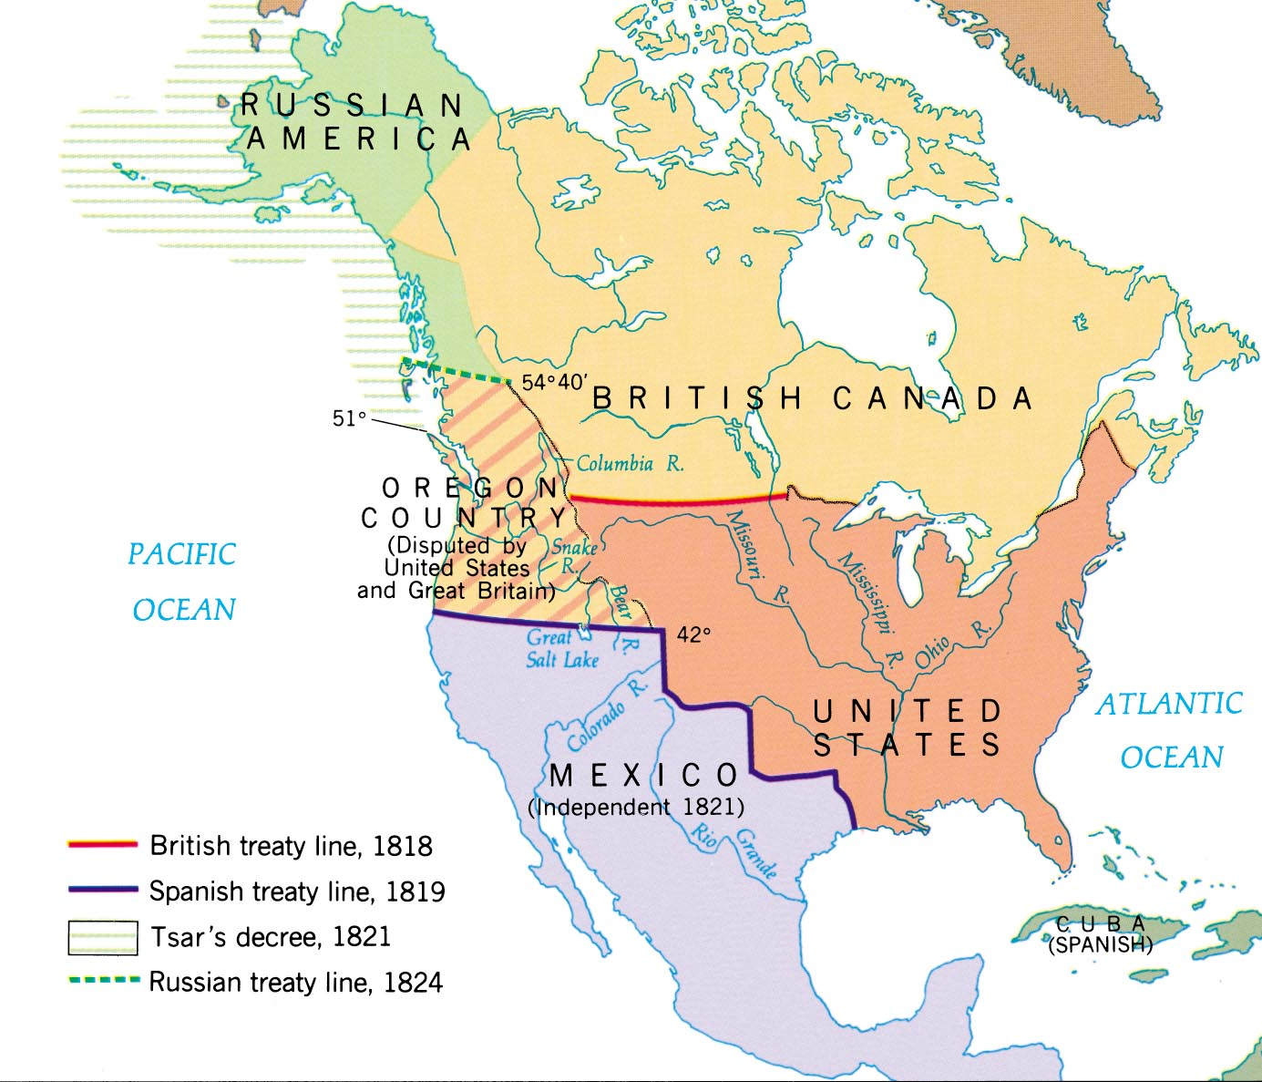
The West & the NW: 1819-1824

Slide 25
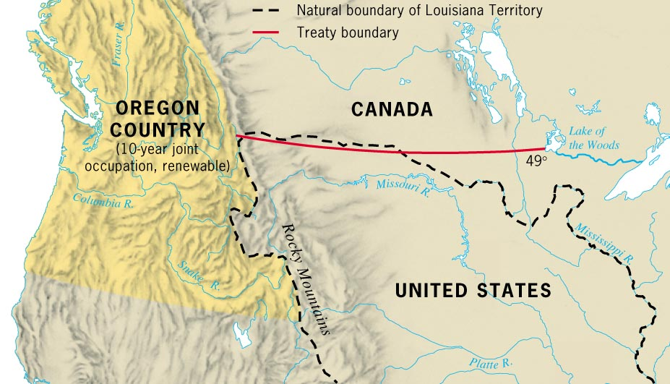
The Convention of 1818

Slide 26
49th Parallel
Rush-Bagot Treaty of 1818 with Great Britain
Agreed to joint occupation

Slide 27
Westward Expansion
Rush-Bagot Agreement (1817-18)
  Treaty with Great Britain
    Shared Oregon Territory for 10 years
    the setting of the northern limits of the Louisiana Territory at the 49th parallel
      US agreed to cede land above 49th parallel
      GB agreed to cede land below 49th parallel

Slide 28
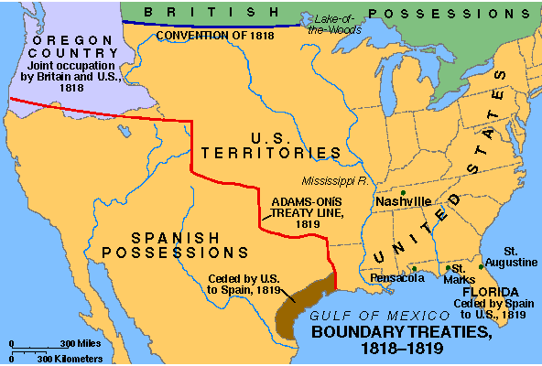
Adams-Onis Treaty, 1819

Slide 29
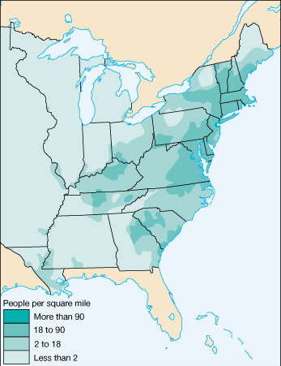
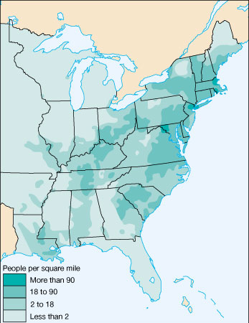
US Population Density
1810
1820

Slide 30
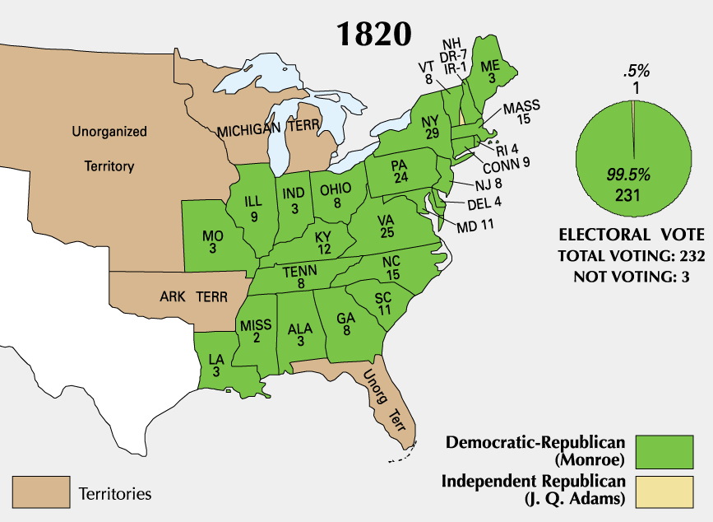
The Election of 1820

Slide 31
JAMES MONROE
1817 TO 1825
UP CLOSE AND PERSONAL
Born in Virginia in 1758,
Attended the College of William and Mary,
Fought with Continental Army
Practiced law in Virginia.
Elected United States Senator
Helped negotiate the Louisiana Purchase.
Elected President in 1816 and served from 1817 to 1825.
Era of Good Feelings
President James Monroe

Slide 32
ERA OF GOOD FEELINGS
1817 TO 1825
Spirit of Nationalism in US
  patriotism or national oneness
  Country is united, confident, and growing
  1791-1819, 9 states joined the original 13.
One political party---Republican party
Respect from Europe
Monroe first president to visit all states.
Boston newspaper declared an “Era of Good Feelings” had began.
  But, time period was not free of problems.

Slide 33
ERA OF GOOD FEELINGS
Cultural Nationalism
  Patriotic themes infused every aspect of American society from books and paintings of Revolutionary heroes to Noah Webster’s blue-backed speller that promoted patriotism
Economic Nationalism
  Running parallel with cultural nationalism was a political movement to support the growth of the nation’s economy--------AMERICAN SYSTEM
Political Nationalism
  Movement to bring about the support for national government is over the states. Supreme court decisions support the concept of national government over the states.

Slide 34
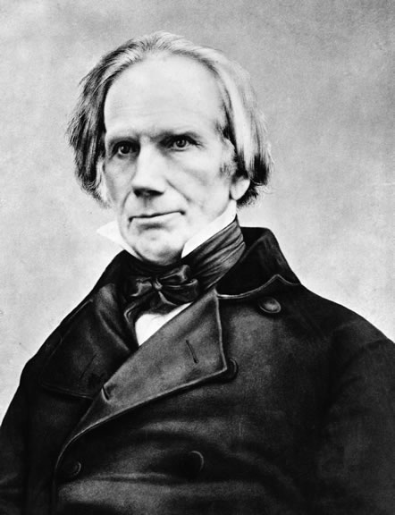
Henry Clay’s
American System
AMERICAN SYSTEM
american system
Congress’s attempt to unite the US
  National transportation system of roads, canals, steamships and rivers.
  1800 to 1850 roads, canals and rivers first forms of transportation---
Provide economic growth
  Americans buying American goods
  American self-sufficiency.
Protective Tariff to promote infant industry
  Tariff of 1816
2nd BUS to promote a stronger economy
  Rechartered in 1816

Slide 35
ERA OF GOOD FEELINGS
National Transportation system
  Cumberland Road and Erie Canal first internal improvements to unite the US
  the first steamboat on western waters was in 1811.
  1800 to 1850 roads, canals and rivers first forms of transportation
  1850 to 1860 the railroad is added
The Land Act of 1820
  gave the West its wish by authorizing a buyer to purchase 80 acres of land at a minimum of $1.25 an acre in cash;
  the West demanded transportation.

Slide 36
The American System
WEST → got roads, canals, and
federal aide.
EAST → got the backing of
protective tariffs from the
West.
SOUTH → ??

Slide 37
Reasons for
Westward Movement
Population shift from the east to the West
Acquisition of Native Americans’ lands
Land easy to obtain
Economic pressures
Improved transportation
Immigration

Slide 38
New Questions and Issues
ERA OF GOOD FEELINGS
Greatest importance to western states were:
  “Cheap money” (easy credit) from state banks rather than from the Bank of the United States
  Land made available at low prices by the government
  Improved transportation
Westerners could not agree whether to permit slavery or exclude it

Slide 39
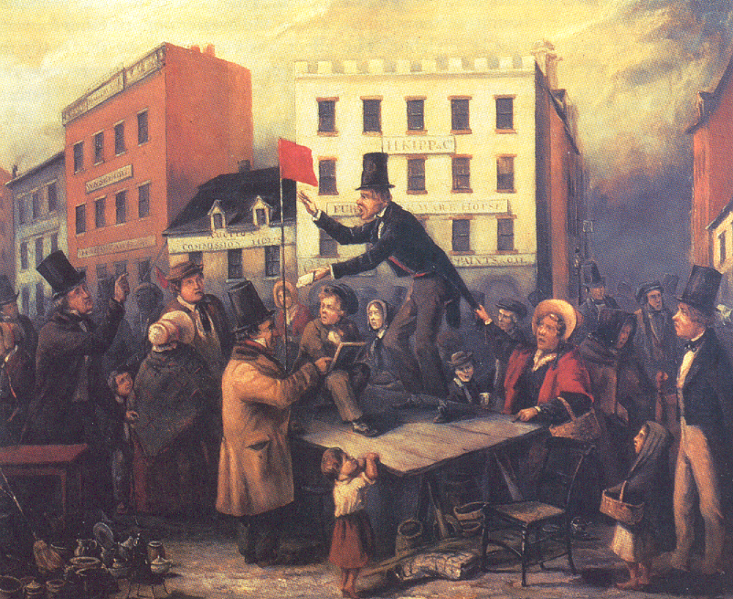
The Panic of 1819

Slide 40
The Panic of 1819
ERA OF GOOD FEELINGS
Largely the fault of the Second Bank of the United States’ tightening of credit in an effort to control inflation
  Many state banks closed
  The value of money fell
  There were large increases in unemployment, bankruptcies, and imprisonment for debt
Depression was most severe in the West
The economic crisis changed many Western voters’ political outlook

Slide 41
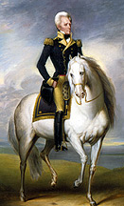
Westward Expansion
Florida Becomes Part of US
  After War of 1812, Spain had difficulty governing Florida
  Seminole Indians, runaway slaves, and white outlaws conducted raids into U.S. territory and retreated to safety across the Florida border
President Monroe commissioned General Andrew Jackson to stop the raiders
  Jackson led a force into Florida, destroyed Seminole villages, and hanged 2 Seminole chiefs
  Jackson captured Pensacola and drove out the Spanish governor

Slide 42
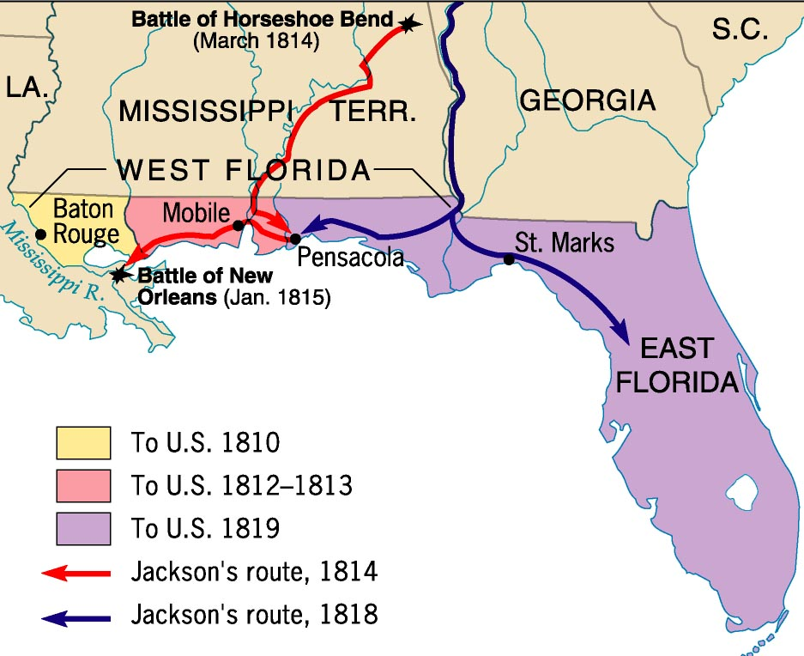

Slide 43
Westward Expansion
Adams-Onis Treaty (1818)
  Spain turned over
    western Florida along with all to the east
    Claims in the Oregon Territory to the U.S.
  US agreed
    to pay $5 million to Spain
    to give up any territorial claims to Texas

Slide 44
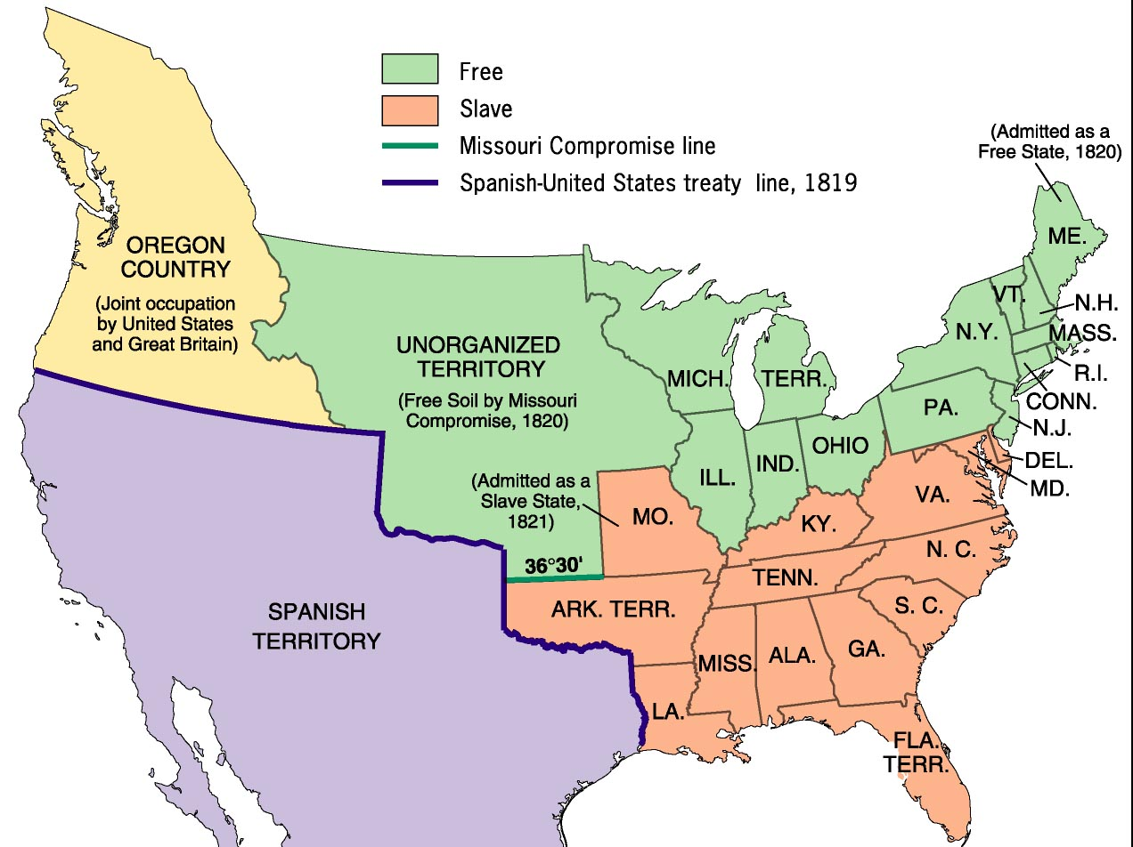
The Compromise of 1820:
A Firebell in the Night!

Slide 45
The Tallmadge Amendment
All slaves born in Missouri after the
territory became a state would be freed
at the age of 25.
Passed by the House, not in the Senate.
The North controlled the House, and the
South had enough power to block it in
the Senate.

Slide 46
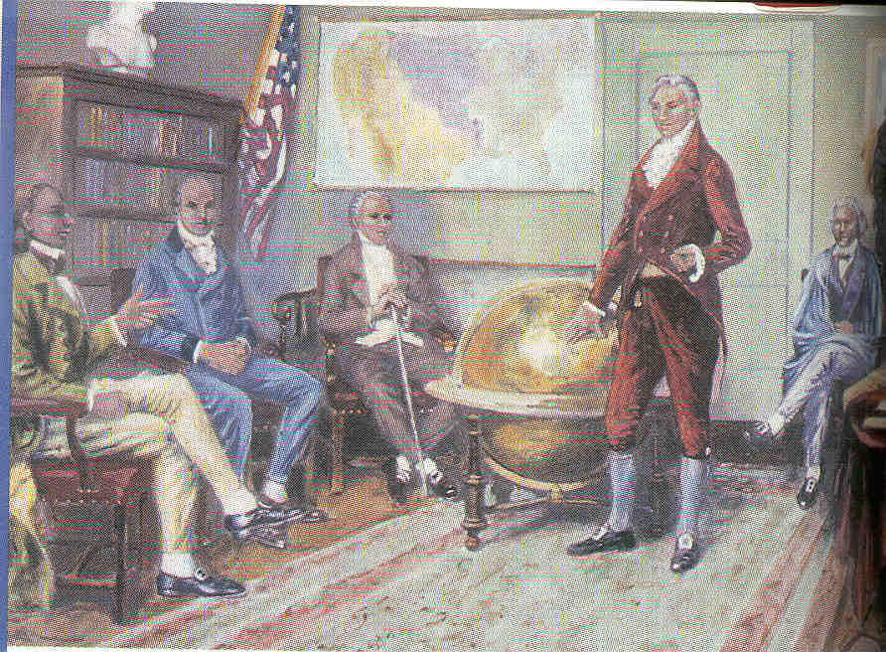
The Monroe Doctrine, 1823
Referred to as
America’s Self-Defense
Doctrine.
What warning is given to the European countries?
What foreign policy
principles are established?
Monroe
Doctrine
What would the US do if the warning was not headed?

Slide 47
MONROE DOCTRINE
monroe doctrine
In foreign affairs Monroe proclaimed the fundamental policy that bears his name, Monroe Doctrine.
Monroe was responding to the threat that Europe might try to aid Spain in winning back her former Latin American colonies.
Monroe and Secretary of State John Quincy Adams wanted to protect new “republics” in the Western Hemisphere.
Great Britain, with its powerful navy, also opposed re-conquest of Latin America and suggested that the United States join in proclaiming "hands off."

Slide 48
MONROE DOCTRINE
monroe doctrine
Adams advised, "It would be more candid ... to avow our principles explicitly to Russia and France, than to come in as a cock-boat in the wake of the British man-of-war."
Monroe accepted Adams's advice.
Not only must Latin America be left alone, he warned, but also Russia must not encroach southward on the Pacific coast. ". . . the American continents,"
He stated, "by the free and independent condition which they have assumed and maintain, are henceforth not to be considered as subjects for future colonization by any European Power."

Slide 49
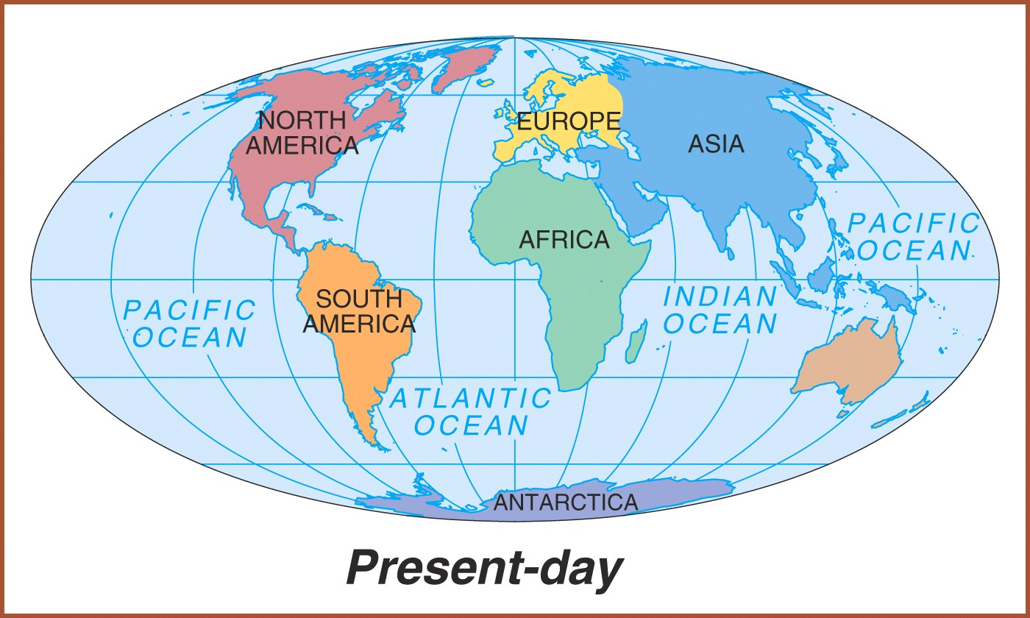
Western Hemisphere or the Americas.

Slide 50
MONROE DOCTRINE
Referred to as America’s Self Defense Doctrine.
It is a continuation of President Washington’s neutrality and isolationist policies.
Past problems with Europe led the US to declare the Americas off-limits to Europe
US recognized existing European Colonies
US protector of new democracies in the Western Hemisphere
No European Colonization in the Americas
Monroe
Doctrine
US will stay out of European affairs
Notes:
Responding to Russian territorial claims along the northern Pacific coast, and concerned that European nations would attempt to seize recently independent Latin American states, President James Monroe announced a new national policy. No new colonies would be allowed in the Americas, and European powers were not to interfere in the affairs of the Western Hemisphere. This mural depicts a discussion among the president and members of his cabinet; from left to right are President James Monroe, Secretary of State John Quincy Adams, Attorney General William Wirt, Secretary of War John Calhoun, and Secretary of the Navy Samuel L. Southard.

Slide 51
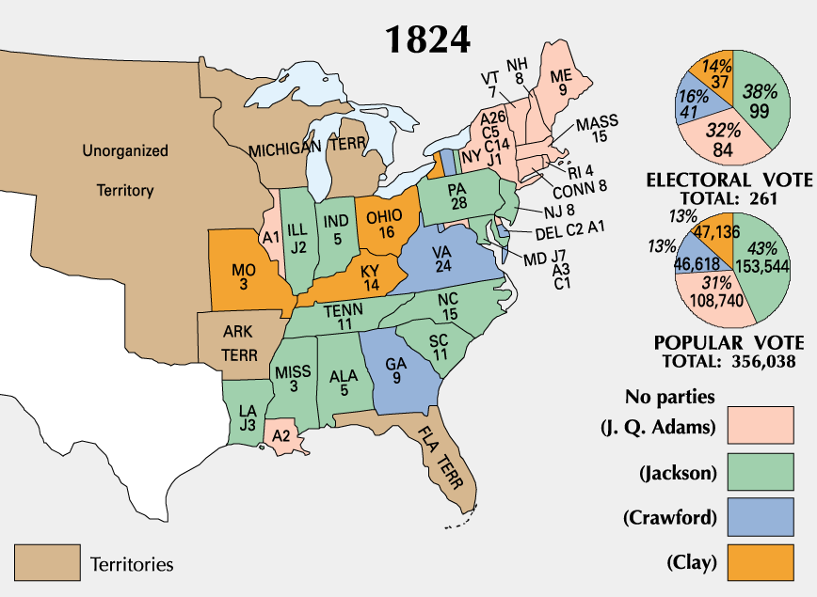
The Election of 1824:
The “Corrupt Bargain”

Slide 52
The Election of 1824:
The “Corrupt Bargain”
Candidate | Popular Vote | Electoral Vote
Andrew Jackson | 43% | 99
J.Q. Adams | 31% | 32
William Crawford | 13% | 41
Henry Clay | 13% | 37

